Slide 1


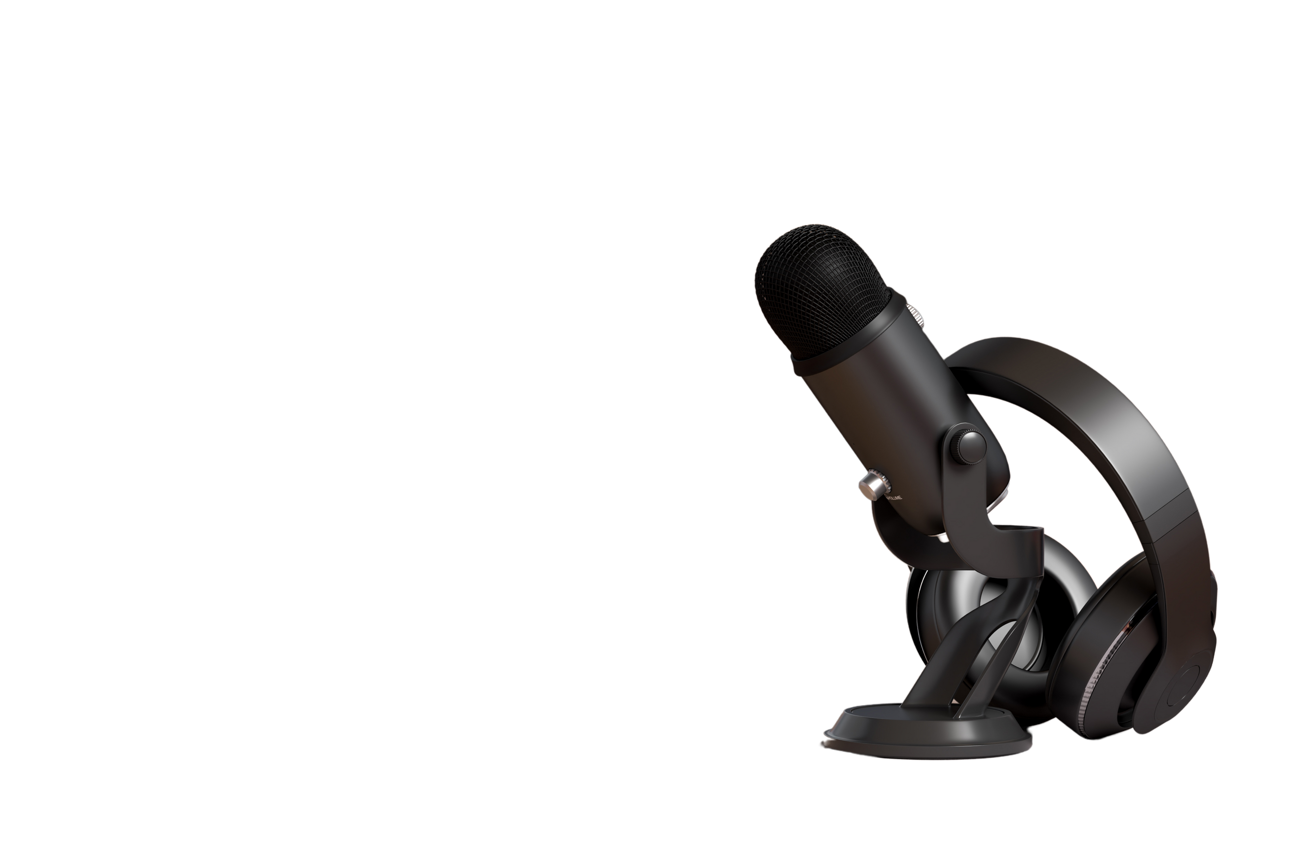

LINEAR
REGRESSION

Slide 2




Q1
Q1
E - Commerce Dataset
Using Linear Regression
Subject
MLPR
Q1
Department of Computer engineering and Information Technology

Slide 3

What ?
Analyze customer data to understand purchasing behavior and predict annual spending using linear regression.​

Slide 4
WHY ?
Problem Statement
Assist the company in deciding whether to enhance the mobile app experience or the website to boost sales.​

Slide 5
Dataset Overview
Average Session Length
Time on App
Time on Website
Length of Membership
Yearly Amount Spent

Slide 6
EDA
Data Cleaning: Handled missing values and outliers.​
Descriptive Statistics: Summarized mean, median, and standard deviation of features.​
Visualizations: Histograms and box plots to show data distributions.

Slide 7
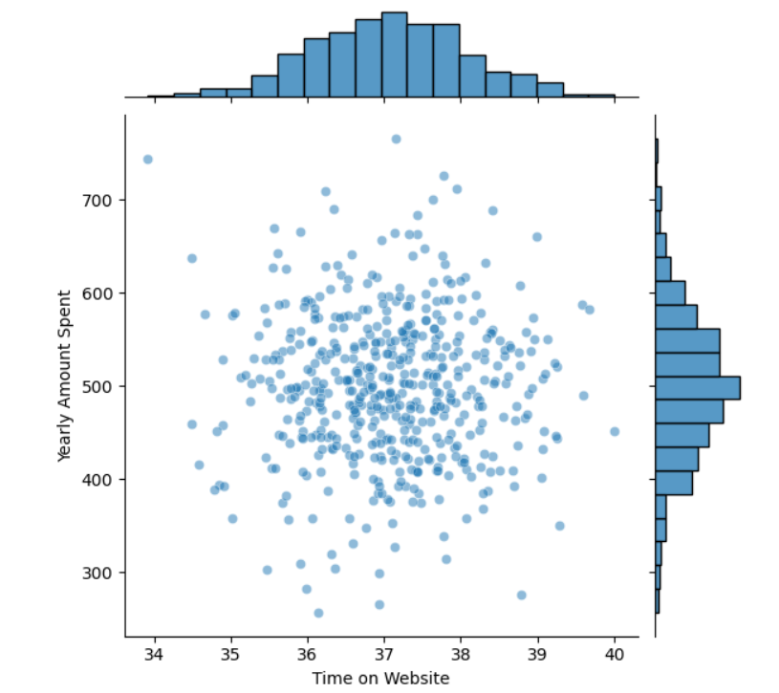

Slide 8
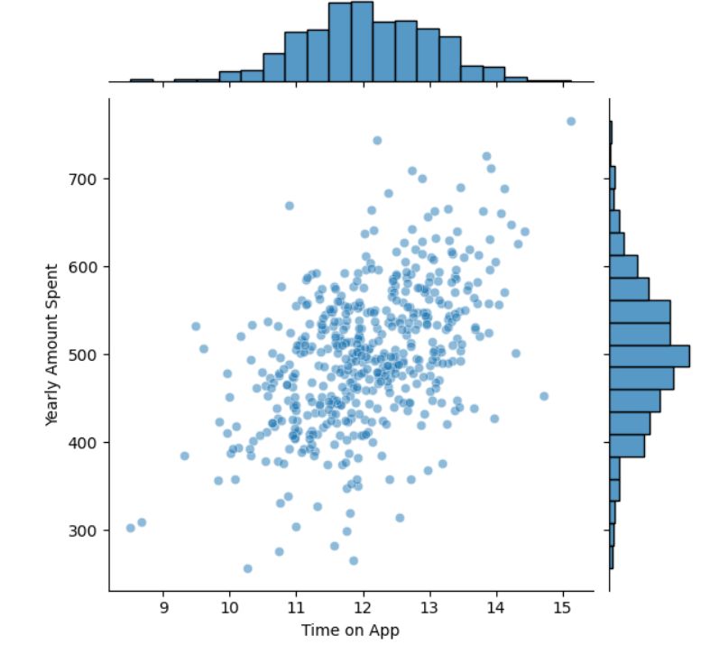

Slide 9
Feature Relationships
Length of Membership has a strong positive correlation with Yearly Amount Spent.
Time on App shows a moderate positive correlation.
Time on Website has a weak correlation.

Slide 10
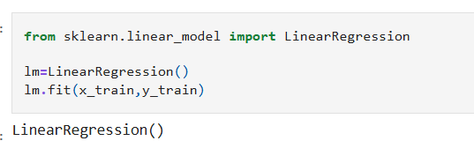
Linear Regression Model Development
Feature Selection: Included all features based on correlation analysis.​
Data Splitting: Divided data into training and testing sets (80/20 split).​
Model Training: Used Ordinary Least Squares (OLS) method.

Slide 11
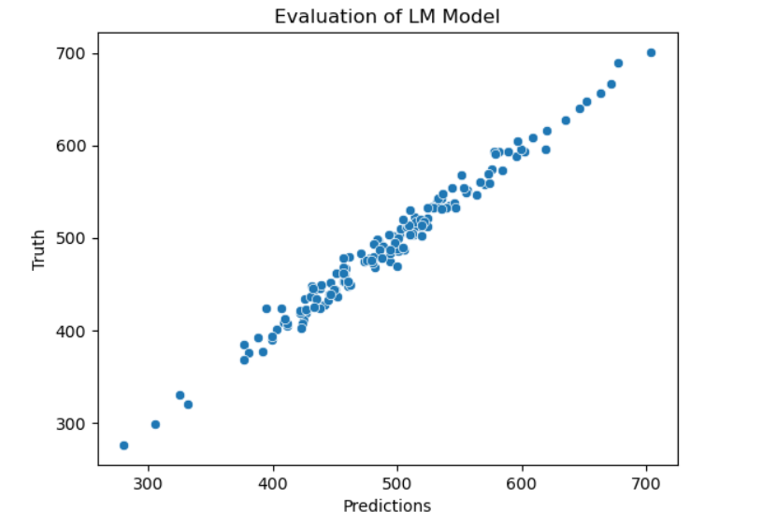
Model Evaluation
Performance Metrics:
R-squared: 98.58%
Mean Absolute Error (MAE): 8.12
Root Mean Squared Error (RMSE): 10.15
Interpretation: The model explains a high proportion of variance in yearly spending, with low prediction errors.

Slide 12
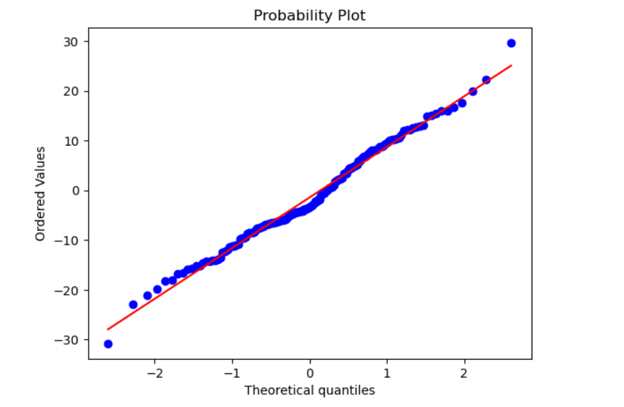
Residual Analysis
Residual Plots: Displayed residuals to check for patterns.​
Normality Check: Residuals approximately follow a normal distribution, indicating a good model fit.

Slide 13
Recommendations
Enhance Mobile App: Given the significant correlation between Time on App and spending, improving app features could increase sales.​
Customer Retention: Focus on strategies to increase membership length, as it strongly correlates with higher spending

